Slide 1
Lecture 41
Young’s Experiment and Interference of Light waves

Slide 2
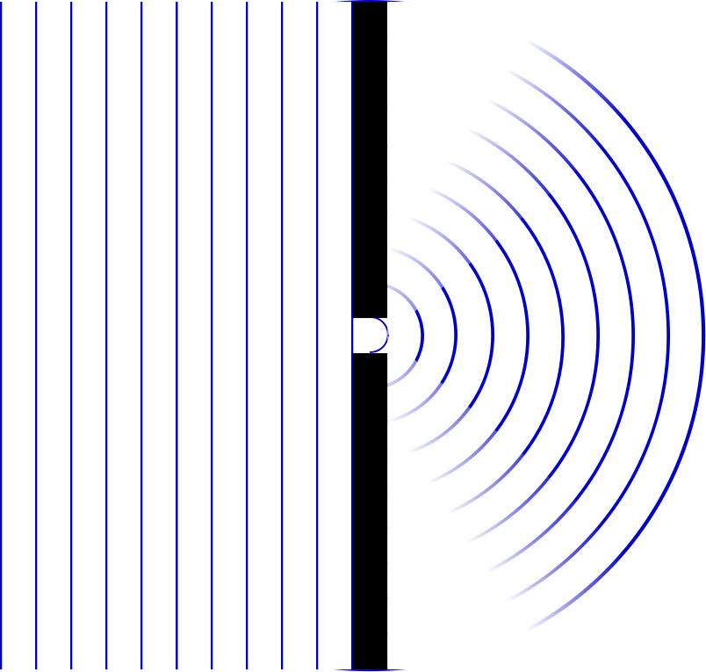

Slide 3
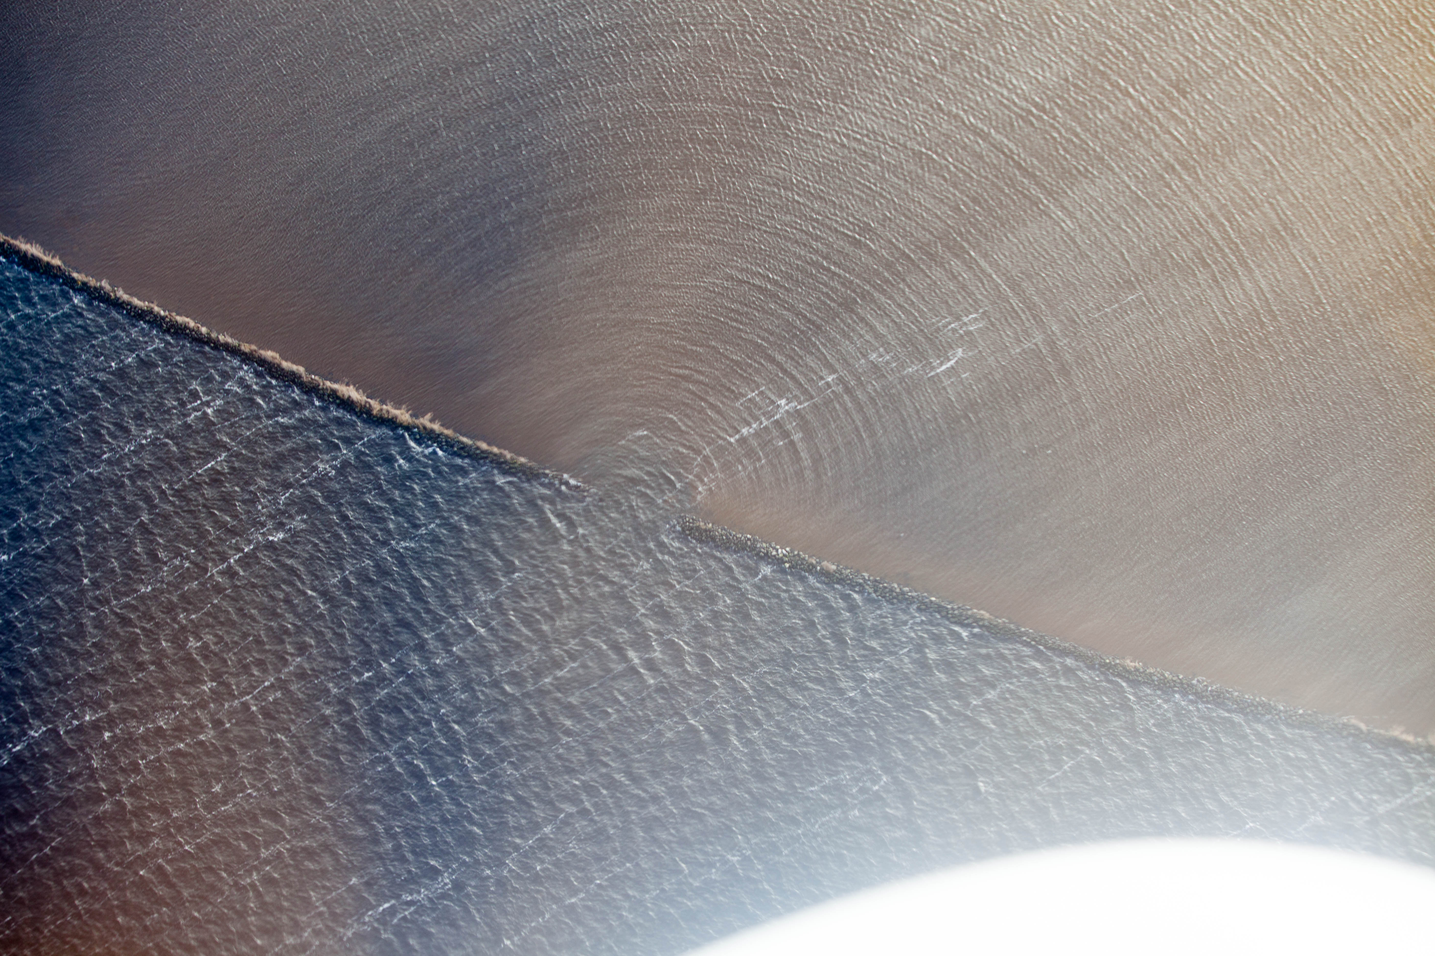
Jeroen Komen from Utrecht, Netherlands
https://commons.wikimedia.org/wiki/File:Waves_changing_direction_through_a_narrow_opening_(20243395322).jpg

Slide 4
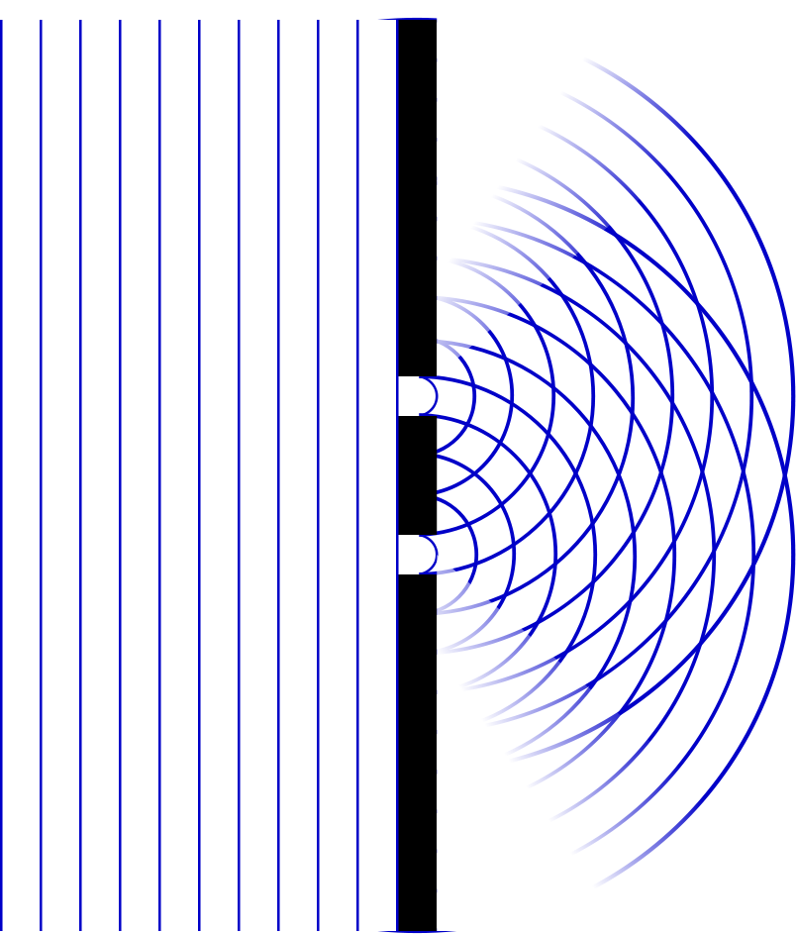

Slide 5
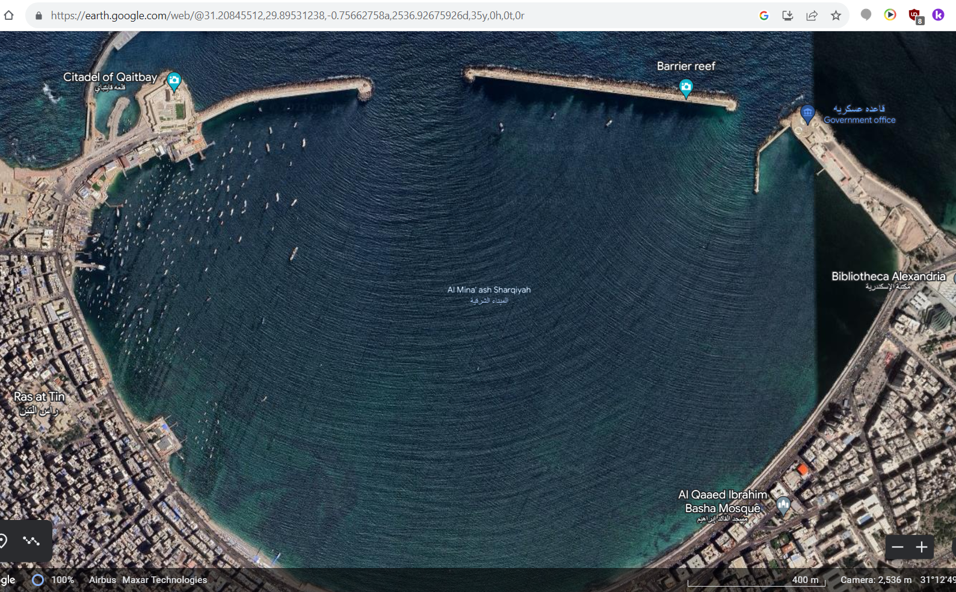

Slide 6
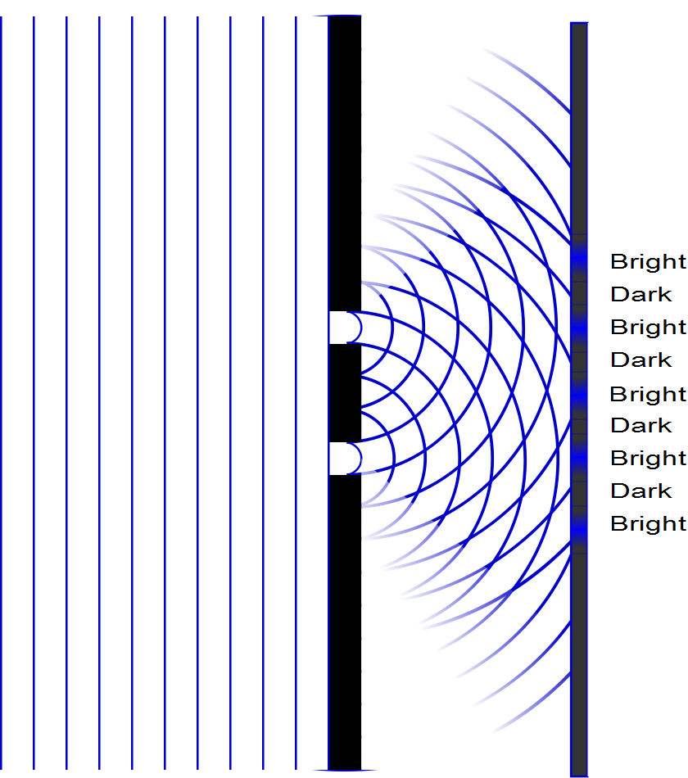

Slide 7
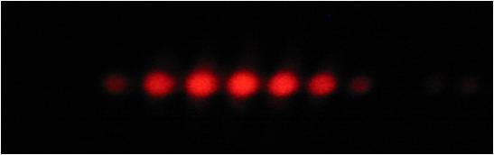

Slide 8
Question 223.10.5
If you see a bright fringe in a “Young’s Experiment,” the path difference from the fringe to the slits must be equal to
And integer number of wavelengths
And integer number of half wavelengths
π
Arctan(θ)

Slide 9
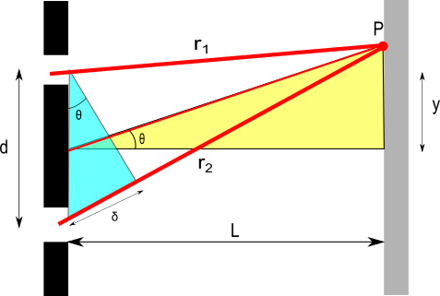
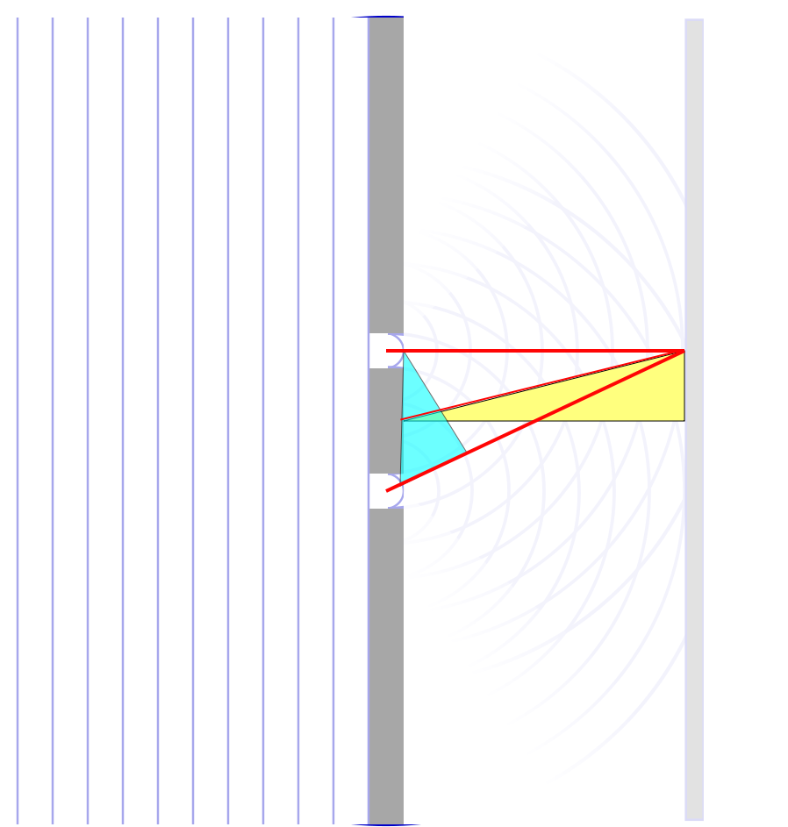

Slide 11
λ
2λ

Slide 12
Question 223.10.6
When considering order numbers, m, the possible orders are
1, 2, 3, . . .
0, 1, 2, 3, . . .
0, ±1, ± 2, ± 3, . . .
±1, ± 2, ± 3, . . .

Slide 13
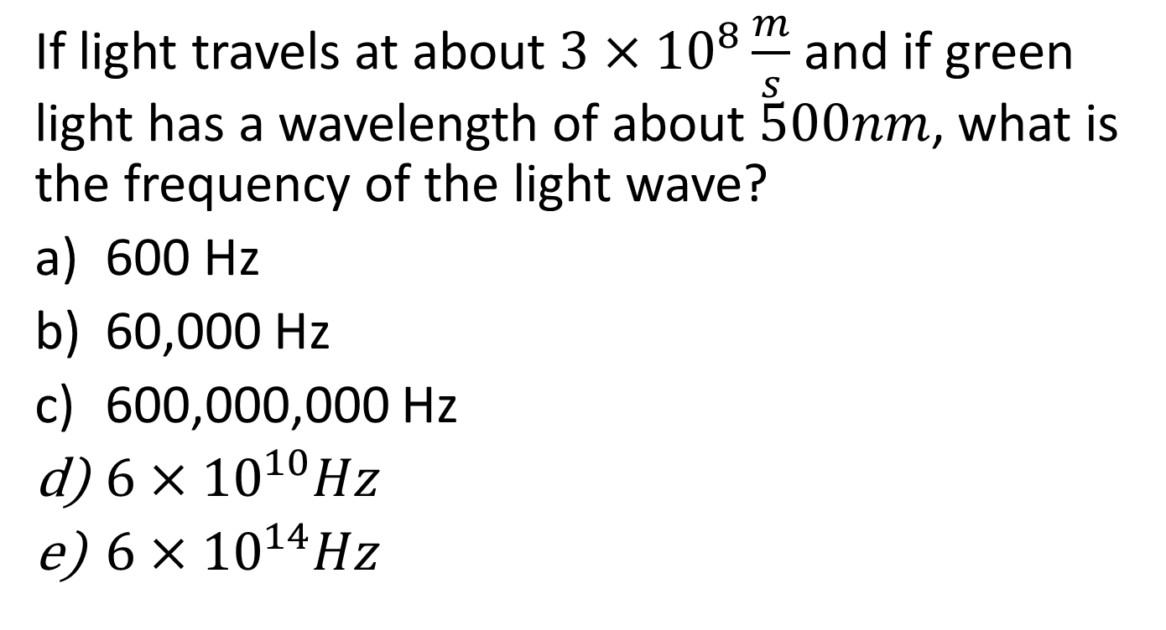
Question
If light travels at about $3×{10}^{8}\frac{m}{s}$ and if green light has a wavelength of about $500nm$, what is the frequency of the light wave?
600 Hz
60,000 Hz
600,000,000 Hz
$6×{10}^{10}Hz$
$6×{10}^{14}Hz$

Slide 14
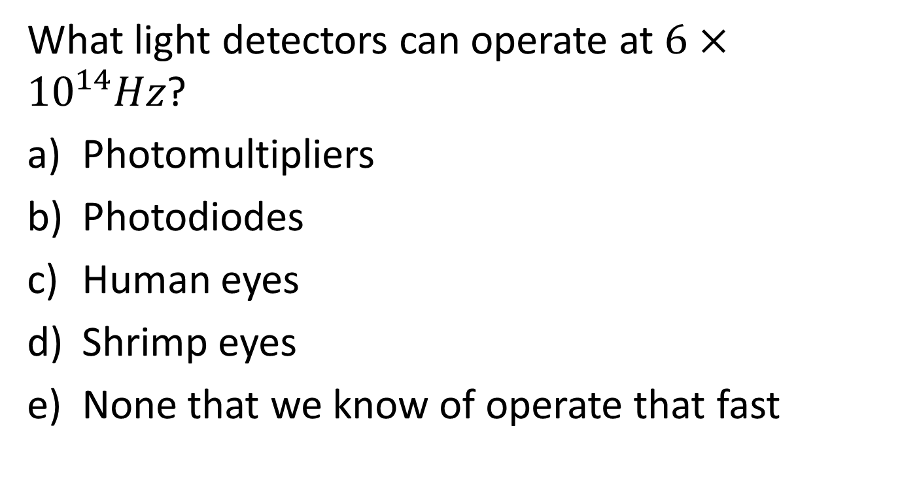
Question
What light detectors can operate at $6×{10}^{14}Hz$?
Photomultipliers
Photodiodes
Human eyes
Shrimp eyes
None that we know of operate that fast

Slide 18
I
Interference fringes:
due to having two slits.
φ/2
-5π
-3π
-π
π
3π
5π

Slide 19
ConcepTest 24.3a Double Slits I
In a double-slit experiment, when the wavelength of the light is increased, the interference pattern
spreads out
stays the same
shrinks together
disappears

Slide 20
ConcepTest 24.3a Double Slits I
In a double-slit experiment, when the wavelength of the light is increased, the interference pattern
spreads out
stays the same
shrinks together
disappears
d sin θ = m λ
If λ is increased and d does not change, then θ must increase, so the pattern spreads out.

Slide 21
ConcepTest 24.3b Double Slits II
If instead the slits are moved farther apart (without changing the wavelength) the interference pattern
spreads out
stays the same
shrinks together
disappears

Slide 22
ConcepTest 24.3b Double Slits II
If instead the slits are moved farther apart (without changing the wavelength) the interference pattern
spreads out
stays the same
shrinks together
disappears
d sin θ = m λ
If instead d is increased and λ does not change, then θ must decrease, so the pattern shrinks together
Follow-up: When would the interference pattern disappear?

Slide 23
ConcepTest 24.4 Path Difference
In a double-slit experiment, what path difference have the waves from each slit traveled to give a minimum at the indicated position?
there is no difference
half a wavelength
one wavelength
three wavelengths
more than three wavelengths
Intensity

Slide 24
ConcepTest 24.4 Path Difference
In a double-slit experiment, what path difference have the waves from each slit traveled to give a minimum at the indicated position?
there is no difference
half a wavelength
one wavelength
three wavelengths
more than three wavelengths
λ
For Destructive Interference
δ = 1/2 λ, 3/2 λ, 5/2 λ, 7/2 λ, …
= (m + 1/2) λ
2λ
3λ
Intensity
λ/2
3λ/2
5λ/2
7λ/2

Slide 25
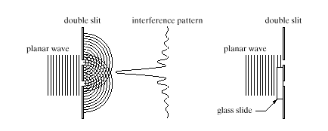
ConcepTest 24.5 Interference Pattern
pattern vanishes
pattern expands
bright and dark spots are interchanged
pattern shrinks
no change at all
An interference pattern is seen from two slits. Now cover one slit with glass, introducing a phase difference of 180° (1/2 wavelength) at the slits. How is the pattern altered?
Double slit Interference pattern
wave

Slide 26
ConcepTest 24.5 Interference Pattern
An interference pattern is seen from two slits. Now cover one slit with glass, introducing a phase difference of 180° (1/2 wavelength) at the slits. How is the pattern altered?
pattern vanishes
pattern expands
bright and dark spots are interchanged
pattern shrinks
no change at all
If the waves originating from the two slits have a phase difference of 180° when they start off, the central spot will now be dark !! To the left and the right, there will be bright spots. Thus, bright and dark spots are interchanged.
Double slit Interference pattern
wave
Follow-up: What happens when the phase difference is 90°?

